Slide 1

DAQ Projects
Summer 2021

Slide 2
Summer 2021 Plans
Performance at Arizona
Meet once per week
What day/time?
Meet on Discord?
Presentations again?
Shorter meetings?

Slide 3
Projects
Tier 1 – Done ASAP (before Louisville)
Tier 2 – Done within 1 month
Tier 3 – Done by end of summer (large projects)
Tier 4 – Done by end of summer (small projects)
Tier 5 – Other projects

Slide 4
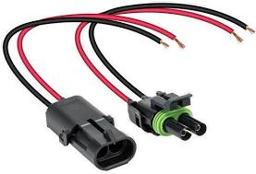
Tier 1
Rewire Car using new connectors
Weatherpack connectors
Figure out why speed sensors aren’t working (Dashboard)
Fix GitHub

Slide 5
GITHUB
Separate repo for DAATA?
Separate repo for resources?
Separate repo for hardware libraries?

Slide 6
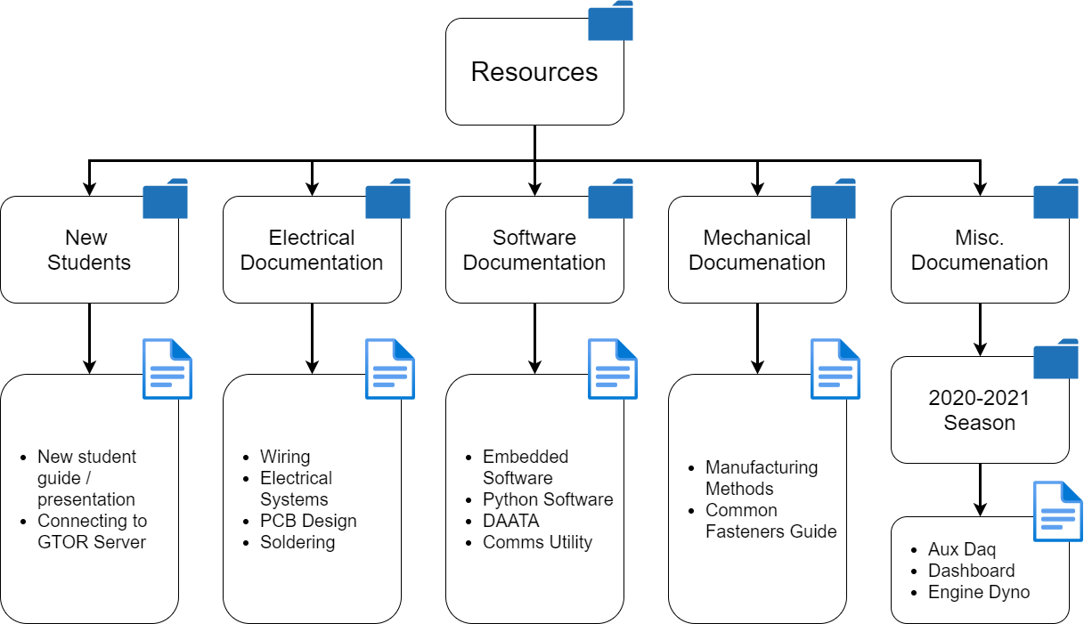
Tier 2 – Documentation!

Slide 7
NEW STudents
New Student Guide (Already Done)
What is DAQ
What software do we use
How to Document - Ryan

Slide 8
Electrical Documentation
Wiring – Ryan, Andrew
Connectors to use / when to use them
When to use specific AWG of wire / color of wire
Standard for assembling connectors
Electrical Systems – Ryan, Andrew
Brake light circuit
Kill switch circuit
Sensors we use

Slide 9
Electrical Documentation
PCB Design – Andrew, Akash or Evelyn
Setting up environment, using GTOR Eagle Lib
Rules of thumb for design (trace widths, etc.)
DFM rules (JLCPCB vs. ME Electronics)
Soldering - Peter
Best practices when soldering
Best solder to use, wick, etc.
How to desolder
Methods to reflow solder

Slide 10
Software Documentation
Embedded Software – Akash, Andrew
Setting up environment
Using our libraries
Style guide
Python software – Ben, Ryan, Andrew
Setting up environment
Installing dependencies
Style guide

Slide 11
Software Documentation
DAATA – Ryan, Ben, Andrew
What is it for
How to use it
Comms Utility – Akash, Ben, Andrew
How to use it (minimal C++ knowledge)
How it works

Slide 12
Mechanical documentation
Manufacturing Methods – Andrew, Cody
Designing for 3D printing
Designing for waterjet, CNC, milling, etc.
Common Fasteners – Andrew, Cody
What fasteners we use on DAQ

Slide 13
Misc. Documentation
Aux DAQ - Evelyn
What went well? What didn’t?
Suggestions for improvement
Dashboard - Akash
Same as Aux DAQ
Dyno – Cody, Peter
How to use
How to calibrate/setup
Recommendations for improvement

Slide 14
Documentation
Ask yourself:
“If I was a freshman joining this team for the first time and I wanted to created a better version of this project, what would be the most useful things to know?”

Slide 15
Tier 3 – Projects!
Power Chest / DAATA Mobile - Peter
Comms Utility - Ben
Aux DAQ V2 / Dashboard V2 - Evelyn
Engine Dyno - Cody
Shock Dyno - Rishab
Light Gates - Aadi
Differential Controller - Ryan
IMUs – Justice
EPIC Lights for MM – Akash
Wireless - Andrew

Slide 16
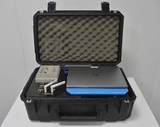
Power chest & daata Mobile
Design and plan for manufacturing battery assembly
BOM to submit bill at beginning of fall

Slide 17
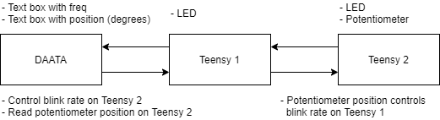
Comms Utility
Test throughput UART
Test communication to DAATA
Write library for LED blinking at certain freq
Write library for potentiometer

Slide 18
Aux Daq / Dashboard
Fully designed in EAGLE, design reviewed, BOM made to submit bill at beginning of semester

Slide 19
Engine Dyno
Whatever is needed to make work ASAP in fall / any improvements that need to be made

Slide 20
Shock Dyno
Redesign this (would also like to get all necessary purchases on a bill)
Might need to contact Billy
Exact requirements of design are still unknown
Need someone to help with electrical design too

Slide 21
Light Gates
Software for it is done and they are fully tested
Electrical part is debugged
(If another revision is needed this will look a little different)

Slide 22
Differential Controller
Work with Jacob to figure out design requirements for this

Slide 23
IMUs
Need to be fully working with Sensor library
Robust calibration method and evaluation of performance (do we need to invest in a different IMU)
These will potentially be a critical system for differential controller, need to be treated as such

Slide 24
Epic lights for MM
Hackathon style?

Slide 25
wireless
Have good documentation for setting up and using XBEE’s and do more range testing, test different antennas, using multiple XBEE’s, etc.
Wireless programming?

Slide 26
Tier 4
Load cells
Other sensors?
Recruiting (Summer is best time to get people started)
GPS
This list will get expanded

Slide 27
Tier 5
Monitoring systems?
Current / voltage measurements on all batteries
Kill switch / brake light monitoring
Rear view camera?
Fix chassis dyno?
Any other projects?

